Slide 1

Dr. Ali Alshdifat
Data Science Department
2024 – 2025
Chapter 2: High Performance Computing

Slide 2
Contents
Introduction to HPC
Parallel Architectures
Multi Cores
Graphical Processing Units
Clusters
Grid Computing
Cloud Computing

Slide 3
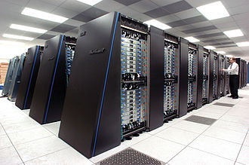
High performance computing-hpc
Ability to process data and perform complex calculations at high speeds
One of the best-known types of HPC solutions is the supercomputer
Supercomputer contains thousands of compute nodes that work together to complete one or more tasks
The IBM Blue Gene/P supercomputer "Intrepid" at Argonne National Laboratory runs 164,000 processor cores using normal data center air conditioning, grouped in 40 racks/cabinets connected by a high-speed 3-D torus network

Slide 4
When do we need hpc?
Case1: Complete a time-consuming operation in less time
I am an automotive engineer
I need to design a new car that consumes less gasoline
I’d rather have the design completed in 6 months than in 2 years
I want to test my design using computer simulations rather than building very expensive prototypes and crashing them
Case 2: Complete an operation under a tight deadline
I work for a weather prediction agency
I am getting input from weather stations/sensors
I’d like to predict tomorrow’s forecast today
Case 3: Perform a high number of operations per seconds
I am an engineer at Amazon.com
My Web server gets 1,000 hits per seconds
I’d like my web server and databases to handle 1,000 transactions per seconds so that customers do not experience bad delays

Slide 5
What does hpc include?
High-performance computing is fast computing
Computations in parallel over lots of compute elements (CPU, GPU)
Very fast network to connect between the compute elements
Hardware
Computer Architecture
Vector Computers, Distributed Systems, Clusters
Network Connections
InfiniBand, Ethernet, Proprietary
Software
Programming models
MPI (Message Passing Interface), SHMEM (Shared Memory), PGAS, etc.
Applications
Open source, commercial

Slide 6
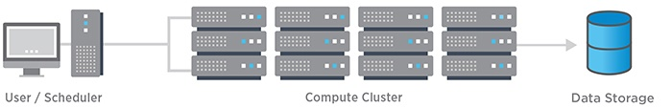
How Does HPC Work?
HPC solutions have three main components:
Compute
Network
Storage
To build a high-performance computing architecture, compute servers are networked together into a cluster
Software programs and algorithms are run simultaneously on the servers in the cluster
Cluster is networked to the data storage to capture the output
Together, these components operate seamlessly to complete a diverse set of tasks

Slide 7
Parallel Architectures
Traditionally, software has been written for serial computation
A problem is broken into a discrete series of instructions
Instructions are executed sequentially one after another
Executed on a single processor
Only one instruction may execute at any moment in time
Parallel computing is the simultaneous use of multiple compute resources to solve a computational problem
A problem is broken into discrete parts that can be solved concurrently
Each part is further broken down to a series of instructions
Instructions from each part execute simultaneously on different processors
An overall control/coordination mechanism is employed

Slide 8
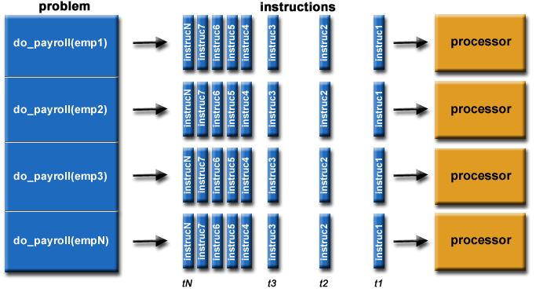
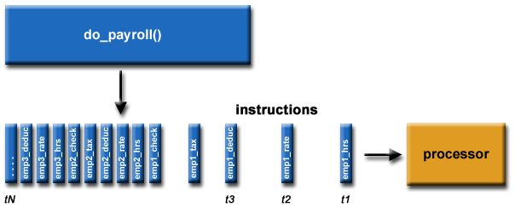
Parallel architectures
Serial Computing
Parallel Computing

Slide 9
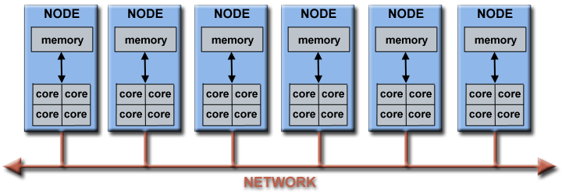
Parallel architectures
Virtually all stand-alone computers today are parallel from a hardware perspective:
Multiple functional units (L1 cache, L2 cache, branch, pre-fetch, decode, floating-point, graphics processing (GPU), integer, etc.)
Multiple execution units/cores
Multiple hardware threads
Networks connect multiple stand-alone computers (nodes) to make larger parallel computer cluster

Slide 10
Why use parallel architectures?
Save time and/or money
Solve larger / more complex problems
Provide concurrency
Take advantage of non-local resources
Make better use of underlying parallel hardware

Slide 11
Types of parallelism
Data Parallelism
Focuses on distributing the data across different parallel computing nodes
Also called as loop-level parallelism
Example: CPU A could add all elements from the top half of the matrices, while CPU B could add all elements from the bottom half of the matrices
Since the two processors work in parallel, the job of performing matrix addition would take one half the time of performing the same operation in serial using one CPU alone
Task Parallelism
Focuses on distribution of tasks across different processors
Also known as functional parallelism or control parallelism
As a simple example, if we are running code on a 2-processor system (CPUs "a" & "b") in a parallel environment and we wish to do tasks "A" and "B" , it is possible to tell CPU "a" to do task "A" and CPU "b" to do task 'B" simultaneously, reducing the runtime of the execution

Slide 12
Parallel architectures
Flynn's taxonomy distinguishes multi-processor computer architectures according to how they can be classified along the two independent dimensions of Instruction Stream and Data Stream
Flynn’s classical taxonomy of Parallel Architectures:
SISD – Single Instruction stream Single Data stream
SIMD – Single Instruction stream Multiple Data stream
MISD – Multiple Instruction stream Single Data stream
MIMD – Multiple Instruction stream Multiple Data stream

Slide 13
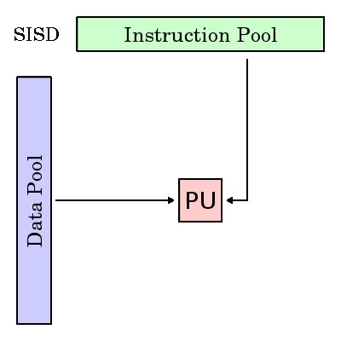
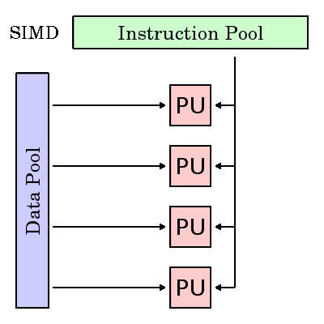
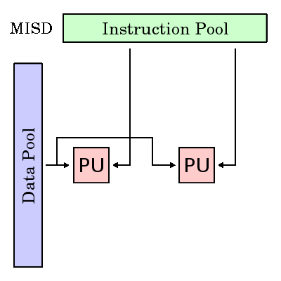
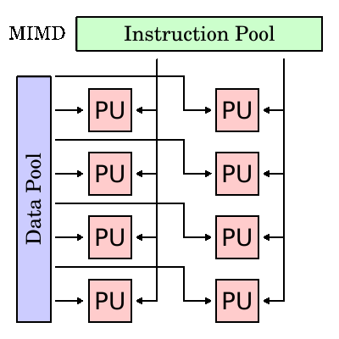
Flynn’s classical taxonomy
SISD | SIMD | MISD | MIMD
Serial Only one instruction and data stream is acted on during any one clock cycle Examples: older generation mainframes, minicomputers, workstations and single processor/core PCs | All processing units execute the same instruction at any given clock cycle Each processing unit operates on a different data element Most modern computers, particularly those with GPUs employ SIMD instructions and execution units | Different instructions operated on a single data element. Example: Multiple cryptography algorithms attempting to crack a single coded message | Can execute different instructions on different data elements. Examples: Most current supercomputers, networked parallel computer clusters and "grids", multi-processor computers, multi-core PCs

Slide 14
Parallel Computer Memory Architectures: shared memory architecture
All processors access all memory as a single global address space & data sharing is fast
Multiple processors can operate independently but share the same memory resources
Changes in a memory location effected by one processor are visible to all other processors
Shared memory machines have been classified as UMA and NUMA, based upon memory access times
Uniform Memory Access (UMA) | Non-Uniform Memory Access (NUMA)
Commonly represented today by Symmetric Multiprocessor (SMP) machines Identical processors, equal access and access times to memory Sometimes called CC-UMA - Cache Coherent UMA. Cache coherent means if one processor updates a location in shared memory, all the other processors know about the update. | Often made by physically linking two or more SMPs One SMP can directly access memory of another SMP Not all processors have equal access time to all memories Memory access across link is slower If cache coherency is maintained, then may also be called CC-NUMA - Cache Coherent NUMA

Slide 15
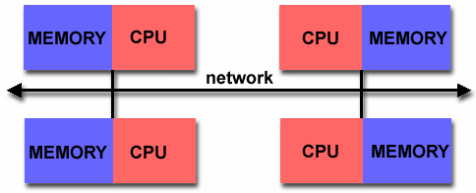
Parallel Computer Memory Architectures: distributed memory architecture
Each processor has its own memory
Programmer is responsible for many details of communication between processors
Each processor has its own local memory, it operates independently. Changes it makes to its local memory have no effect on the memory of other processors. Hence, the concept of cache coherency does not apply
When a processor needs access to data in another processor, it is usually the task of the programmer to explicitly define how and when data is communicate
Synchronization between tasks is likewise the programmer's responsibility

Slide 16
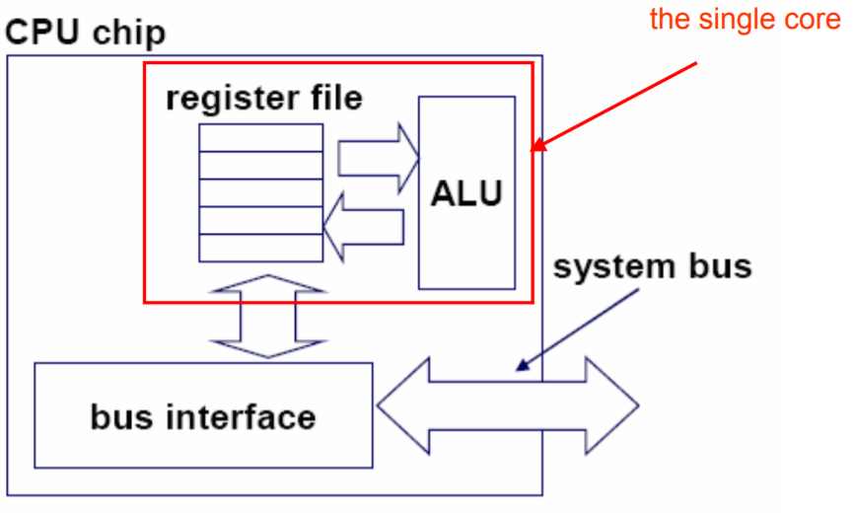
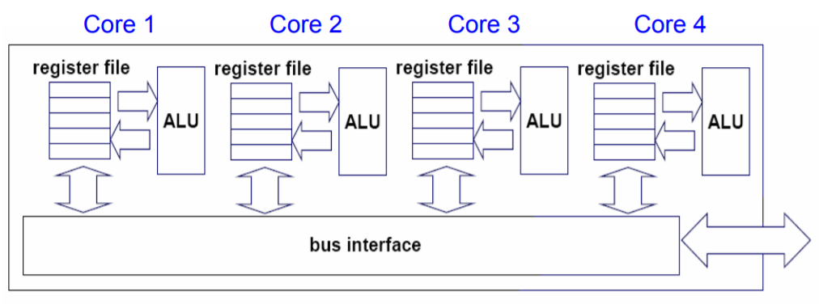
Multi cores
A multi-core processor is a single computing component with two or more independent processing units called cores, which read and execute program instructions
Single Core CPU Chip
Multi-Core CPU Chip

Slide 17
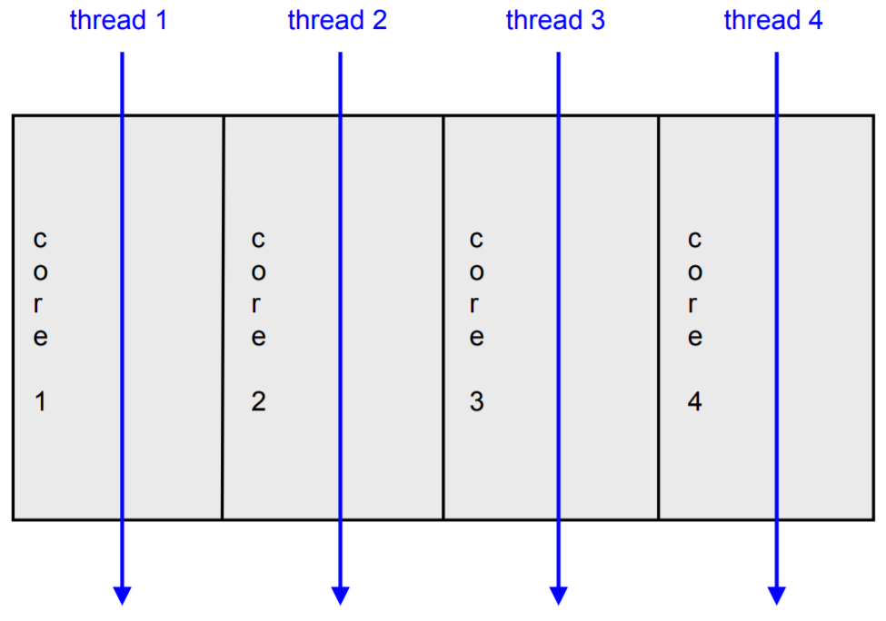
Multi-cores
The cores fit on a single processor socket
Also called CMP (Chip Multi-Processor)
The cores run in parallel
Interaction with OS:
OS perceives each core as a separate processor
OS scheduler maps threads/processes to different cores
Most major OS support multi-core today

Slide 18
Why multi-cores?
Difficult to make single-core clock frequencies even higher
Deeply pipelined circuits:
heat problems
speed of light problems
difficult design and verification
large design teams necessary
server farms need expensive air-conditioning
Many new applications are multithreaded
General trend in computer architecture (shift towards more parallelism)

Slide 19
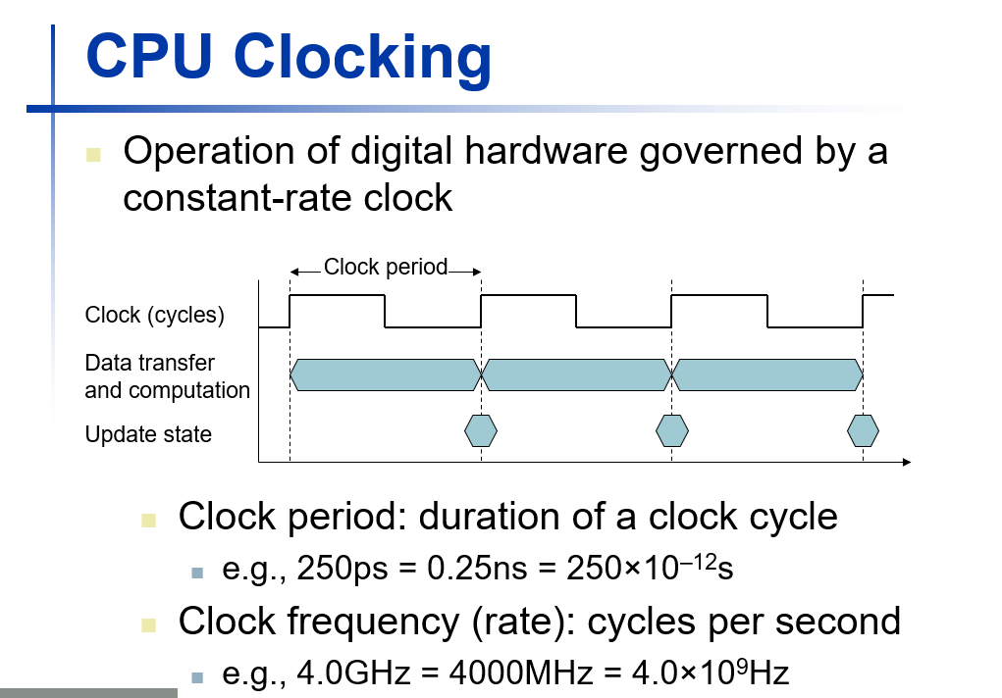

Slide 20
Multi-cores
Multi-core processors are MIMD
Different cores execute different threads ( Multiple Instructions), operating on different parts of memory ( Multiple Data)
Multi-core is a shared memory multiprocessor
All cores share the same memory

Slide 21
What applications benefit from multi-core?
Database servers
Web servers (Web commerce)
Compilers
Multimedia applications
Scientific applications, CAD/CAM
Editing a photo while recording a TV show through a digital video recorder
Downloading software while running an anti-virus program
Anything that can be threaded today will map efficiently to multi-core

Slide 22
Multi-cores: cache coherence problem
Cache coherence is the uniformity of shared resource data that ends up stored in multiple local caches
When clients in a system maintain caches of a common memory resource, problems may arise with incoherent data, which is particularly the case with CPUs in a multi-core architecture
Coherence Mechanism:
Snooping:
Snooping based protocols tend to be faster, if enough bandwidth is available, since all transactions are a request/response seen by all processors
Snooping isn't scalable. Every request must be broadcast to all nodes in a system
Directory based
Tend to have longer latencies but use much less bandwidth since messages are point to point and not broadcast
For this reason, many of the larger systems (>64 processors) use this type of cache coherence

Slide 23
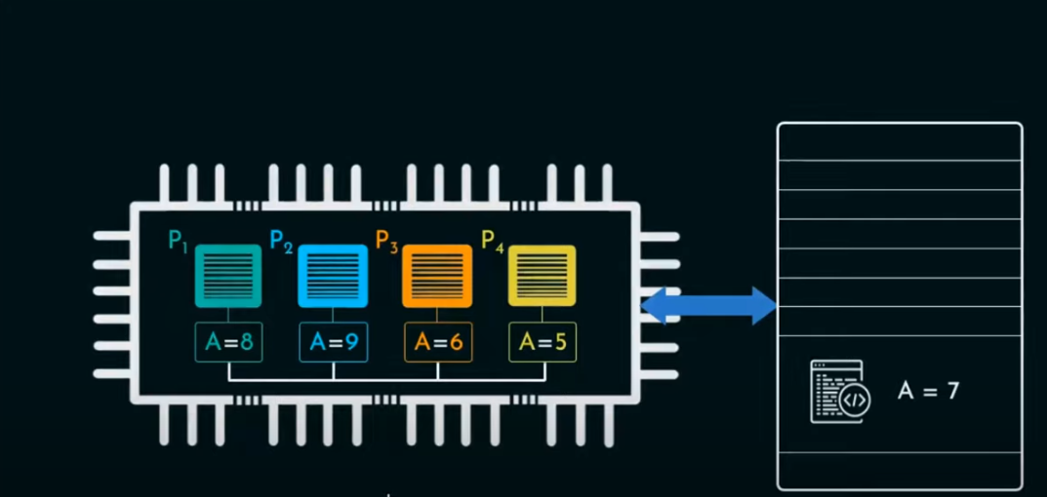

Slide 24
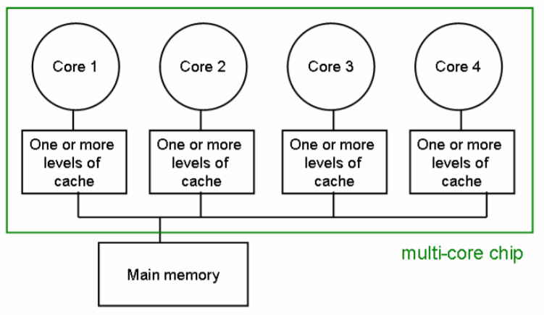
Multi-cores: coherence protocols
Write-invalidate:
When a write operation is observed to a location that a cache has a copy of, the cache controller invalidates its own copy of the snooped memory location, which forces a read from main memory of the new value on its next access
Write-update:
When a write operation is observed to a location that a cache has a copy of, the cache controller updates its own copy of the snooped memory location with the new data

Slide 25
Graphical processing units- gpu
Processor optimized for 2D/3D graphics, video, visual computing, and display
Highly parallel, highly multithreaded multiprocessor optimized for visual computing
Provide real-time visual interaction with computed objects via graphics images, and video
Serves as both a programmable graphics processor and a scalable parallel computing platform
Heterogeneous Systems: combine a GPU with a CPU

Slide 26



Slide 27
GPU Evolution
1980’s – No GPU. PC used VGA controller
1990’s – Add more function into VGA controller
1997 – 3D acceleration functions:
Hardware for triangle setup and rasterization
Texture mapping
Shading
2000 – A single chip graphics processor ( beginning of GPU term)
2005 – Massively parallel programmable processors
2007 – CUDA (Compute Unified Device Architecture)
2010 – AMD’s Radeon cards, GeForce 10 series

Slide 28
Why gpu?
To provide a separate dedicated graphics resources including a graphics processor and memory.
To relieve some of the burden of the main system resources, namely the Central Processing Unit, Main Memory, and the System Bus, which would otherwise get saturated with graphical operations and I/O requests

Slide 29
Gpu vs cpu
A GPU is tailored for highly parallel operation while a CPU executes programs serially.
For this reason, GPUs have many parallel execution units , while CPUs have few execution units .
GPUs have significantly faster and more advanced memory interfaces as they need to shift around a lot more data than CPUs.
GPUs have much deeper pipelines (several thousand stages vs 10-20 for CPUs).

Slide 30
Components of gpu
Graphics Processor
Graphics co-processor
Graphics accelerator
Frame buffer
Memory
Graphics BIOS
Digital-to-Analog Converter (DAC)
Display Connector
Computer (Bus) Connector

Slide 31
clusters
A computer cluster is a group of loosely or tightly coupled computers that work together closely so that in many respects it can be viewed as though it were a single computer.
Connected through fast LAN.
Deployed to improve speed & reliability over that provided by a single computer, while typically being much more cost effective than single computer in terms of speed or reliability.
Middleware is required to manage them

Slide 32
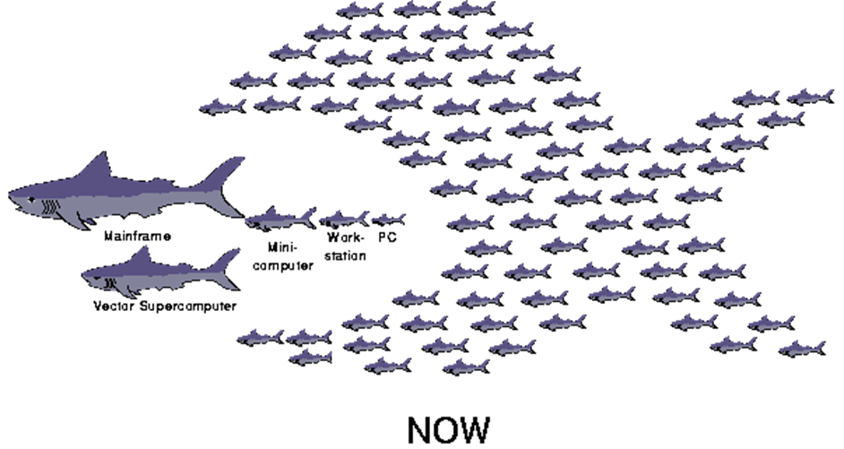
clusters
In cluster computing each node within a cluster is an independent system, with its own operating system, private memory, and, in some cases, its own file system
Processors on one node cannot directly access the memory on the other nodes, programs or software run on clusters usually employ a procedure called "message passing" to get data and execution code from one node to another

Slide 33
Need of clusters
More computing power
Better reliability by orchestrating a number of low cost commercial off-the-shelf computers has given rise to a variety of architectures and configurations
Improve performance and availability over that of a single computer
More cost-effective than single computers of comparable speed or availability
E.g. Big Data

Slide 34
Types of clusters
High Availability Clusters | Load Balancing Clusters | Compute Clusters
Provide uninterrupted availability of data or services (typically web services) to the end-user community In case of node failure, service can be restored without affecting the availability of the services provided by the cluster. There will be a performance drop due to the missing node Implementations: Data mining ,simulations, mission-critical applications or databases, mail, file and print, web, or application servers E.g. Oracle Clusterware | Distributes incoming requests for resources or content among multiple nodes running the same programs or having the same content Every node in the cluster is able to handle requests for the same content or application. Typically, seen in a web-hosting environment E.g. nginx as HTTP load balancer | Used for computation-intensive purposes, rather than handling IO-oriented operations such as web service or databases. Compute clusters vary in the level of coupling Jobs with frequent communications among nodes may require dedicated network, dense location & likely homogenous nodes Jobs with infrequent communication between nodes may relax some of these requirements E.g. Rocks package on Linux

Slide 35
Beowulf clusters
Uses parallel processing across multiple computers to create cheap and powerful supercomputers.
A cluster has two types of computers:
Master or service node or front node : Used to interact with users and manage the cluster.
Nodes : A group of computers (computing nodes) E.g. keyboard, mouse, floppy, video etc.
E.g. OSCAR on Linux
When a large problem or set of data is given to a Beowulf cluster, the master computer first runs a program that breaks the problem into small discrete pieces; it then sends a piece to each node to compute. As nodes finish their tasks, the master computer continually sends more pieces to them until the entire problem has been computed

Slide 36
Clusters-technologies to implement
Parallel Virtual Machine (PVM)
Must be directly installed on every cluster node & provides a set of software libraries that paint the node as a “parallel virtual machine”
Provides a run-time environment for :
Message-passing
Task & Resource management
Fault notification
Message Passing Interface (MPI)
Drew on various features available in commercial systems of the time. The MPI specifications then gave rise to specific implementations
Implementations typically use TCP/IP & socket connections
Widely available communications model that enables parallel programs to be written in languages such as: C, Fortran, Python, etc

Slide 37
Cluster benefits
Availability
Performance
Low Cost
Elasticity
Run Jobs Anytime Anywhere

Slide 38
Grid computing
Grid computing combines computers from multiple administrative domains to reach a common goal
What distinguishes grid computing from Cluster systems such as cluster computing is that grids tend to be more loosely coupled, heterogeneous, and geographically dispersed
Special kind of distributed computing in which different computers within the same network share one or more resources

Slide 39
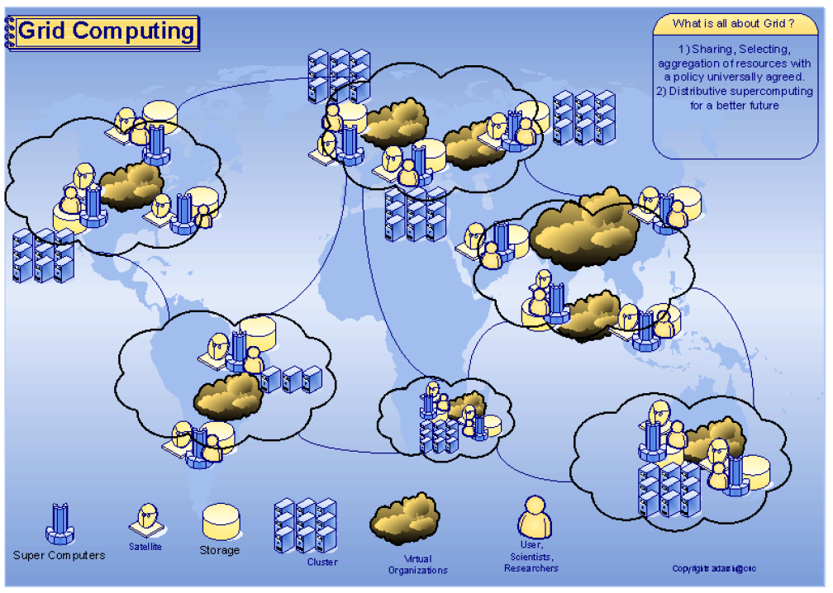

Slide 40
Types of grid computing – data grids
Allows you to distribute your data across the grid
Main goal of Data Grid is to provide as much data as possible from memory on every grid node and to ensure data coherency
Characteristics:
Data Replication- all data is fully replicated to all nodes in the grid
Data Invalidation- Whenever data changes on one of the nodes, then the same data on all other nodes is purged
Distributed Transactions- Transactions are required to ensure Data Coherency
Data Backups- Useful for fail-over. Some Data Grid products provide ability to assign backup nodes for the data
Data Affinity/Partitioning- Allows to split/partition whole data set into multiple subsets and assign every subset to a grid node

Slide 41
Types of grid computing – compute grids
Allows to take a computation, optionally split it into multiple parts, and execute them on different grid nodes in parallel leads to faster rate of execution. E.g. MapReduce
Helps to improve overall scalability and fault-tolerance by offloading your computations onto most available nodes
Characteristics:
Automatic Deployment
Topology Resolution - allows to provision nodes based on any node characteristic or user-specific configuration
Collision Resolution - Jobs are executed in parallel but synchronization is maintained
Load Balancing – proper balancing of your system load within grid
Checkpoints - Long running jobs should be able to periodically store their intermediate state
Grid Events - a querying mechanism for all grid events is essential
Node Metrics - a good compute grid solution should be able to provide dynamic grid metrics for all grid nodes

Slide 42
Grid computing
Advantages:
Can solve larger, more complex problems in a shorter time
Easier to collaborate with other organizations
Make better use of existing hardware
Disadvantages:
Grid software and standards are still evolving
Learning curve to get started
Non-interactive job submission

Slide 43
Cloud computing
Computing paradigm shift where computing is moved away from personal computers or an individual application server to a “cloud” of computers.
Abstraction: Users of the cloud only need to be concerned with the computing service being asked for, as the underlying details of how it is achieved are hidden.
Virtualization: Cloud Computing virtualizes system by pooling and sharing resources

Slide 44
Nist definition of cloud computing
Cloud computing is a model for enabling ubiquitous, convenient, on‐demand network access to a shared pool of configurable computing resources (e.g., networks, servers, storage, applications, and services) that can be rapidly provisioned and released with minimal management effort or service provider interaction

Slide 45
Characteristics of cloud computing
On‐demand self‐service
Broad network access
Resource pooling
Rapid elasticity
Measured service

Slide 46
Cloud components
Clients
Data Center (Collection of Servers where the application to which you subscribe is housed)
Internet

Slide 47
Cloud computing-benefits
Lower Costs
Lower computer costs
Reduced Software Costs
By using the Cloud infrastructure on “pay as used and on demand”, all of us can save in capital and operational investment!
Ease of utilization
Quality of Service
Reliability
Outsourced IT management
Simplified maintenance and upgrade
Low Barrier to Entry
Unlimited storage capacity
Universal document access
Latest version availability

Slide 48
Cloud computing - limitations
Requires a constant Internet connection
Does not work well with low‐speed connections
Larger organizations can have applications more customizable
Security and Privacy issues
Cloud Service provider may go down
Latency concerns

Slide 49
resources
https://www.hpcadvisorycouncil.com/pdf/Intro_to_HPC.pdf
https://computing.llnl.gov/tutorials/parallel_comp/#Whatis
https://www.cs.cmu.edu/~fp/courses/15213-s06/lectures/27-multicore.pdf
https://en.wikipedia.org/wiki/Cache_coherence
https://www.youtube.com/watch?v=A_i5kOlj_UU
https://www.youtube.com/watch?v=bkLVuNfiCVs

